Slide 1
Detection and Tracking
Vehicles and Pedestrians
By Max Litvinenko

Slide 2
Table of contents
How I Started
Tracking
Detection
Decision
Haar
Detection + Tracking
Demo
If I had more time

Slide 3

Started from
Reading academic articles
Tracking
Detection
Understand enough OpenCV to use it
Searched for existing OpenCV demos
OpenCV: Building and Version problems

Slide 4

Tracking
Points on face DEMO #1
Different types, DEMO #2.
MEDIANFLOW = fast + size(predictable)
KCF = med,
TLD, MIL = slow,
BOOSTING = VERY slow

Slide 5
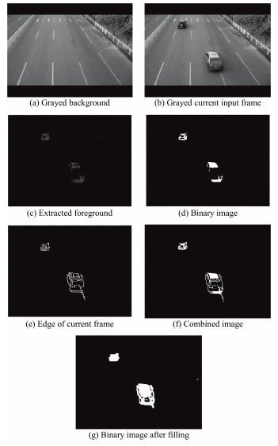
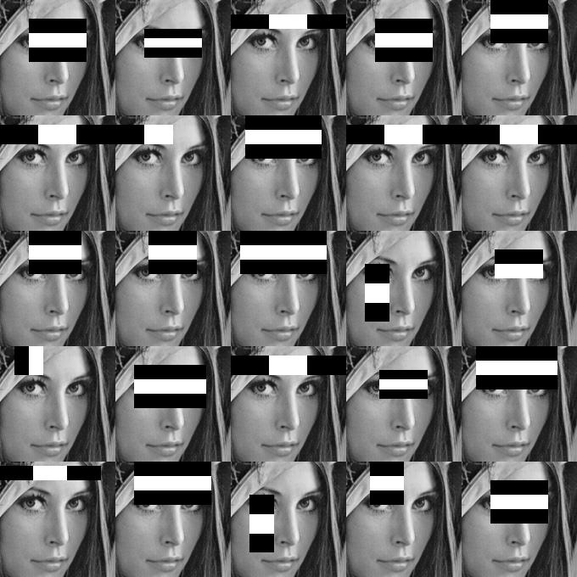
Detection: Decision
VS
Blob
Haar

Slide 6
Detection: Haar
Trained (XMLs)
Cars
Pedestrians
Face Haar Detection -> Vehicle and Peds
Demo Car Detection

Slide 7
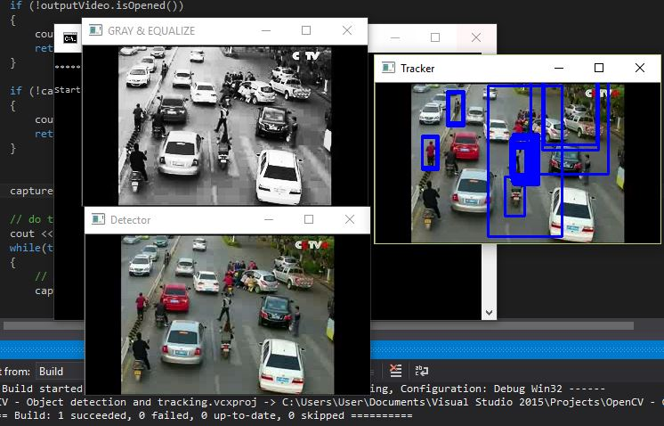
Detection + Tracking
Circle -> Square (Detect. -> Tracking)

Slide 8
Detection + Tracking
Show demo videos # 5-11

Slide 9
If Had More Time
Smooth: Detection with tracking
Remove duplicates
Try different approaches, algorithms
Idea: once Haar detected, convert to blob and track manually
Add car/pedestrian counter
Haar training

Slide 10

Questions?

